Slide 1
THE BEST PLACE FOR HOLIDAYS
–
MASURIAN LAKE DISTRICT
Paweł Pokorski kl. 2D

Slide 2
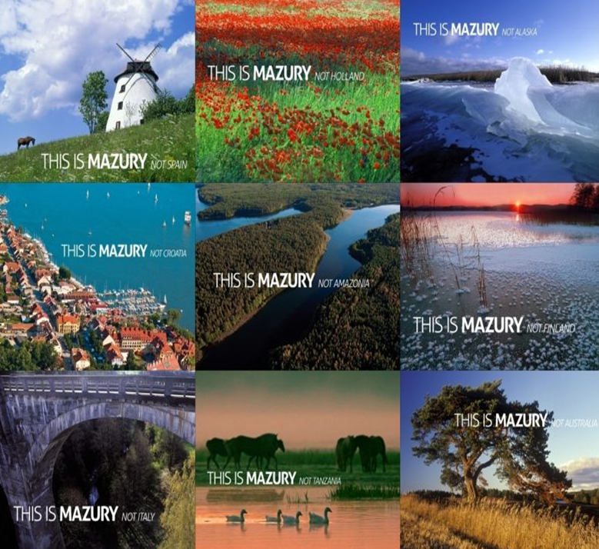
Masuria

Slide 3
Masuria
Geographical region in nothern-eastern Poland.
Landscape of the region was shaped by the last ice age - about 14 000-15 000 years ago.
In the early Middle Ages most of the area covered with wild, primeval forest.
There are about 2000 lakes.

Slide 4
ATTRACTIONS
CITY | ATTRACTION
KĘTRZYN | Teutonic castle, Hitler’s headquarter
MRĄGOWO | Amphitheater near the Czos Lake
GIŻYCKO | Lakes Niegocin, Tajty, Kisajno
WĘGORZEWO | Mamry Lake, The late-Gothic church st. Peter and Paul
EŁK | The ruins of the castle of the Teutonic Knights
MIKOŁAJKI | Marina, promenade
RUCIANE-NIDA | The complex of fortifications from the late XIX/ XX century

Slide 5
Nature
Here has created a local variety called Masurian pine.
The most diverse is the habitat of birds: heron, cormorant, grebe, many species of ducks, swans and cranes, eagle, osprey, lesser spotted eagle.
Mammals: beavers, moose, deer, wolves, foxes, pine martens, badgers
Reptiles: turtle, lizard, grass snake, adder.
Amphibians: newts, frogs, toads , toads lowland
Invertebrates: swallowtail, Cerambyx cerdo
There is also a lot of relicts – the species, which hasn’t evolved : firmoss, woolly delicate, crowberry, bagnica peat, sedge

Slide 6
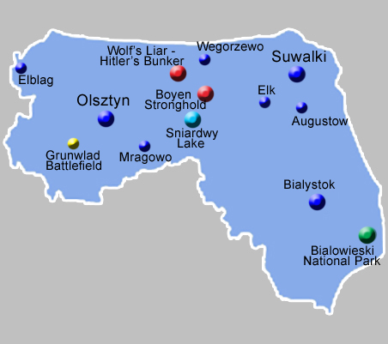
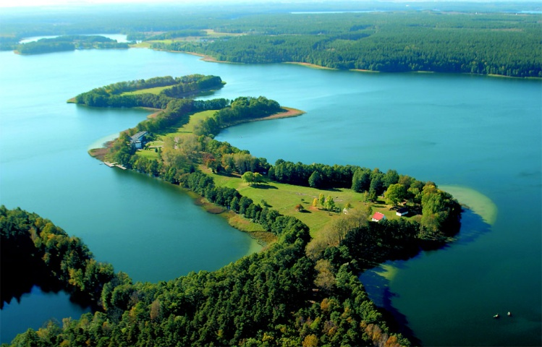
Map of North-East Poland

Slide 7
Thank you for
your attention ☺
Paweł Pokorski

